Slide 1
Blacktown Chinese Christian Church
Welcome to Our English Service 02.02.2025
English Service 9:45 – 11:00 am
Worship Songs: Passage: Speaker: Topic: Response Song: Announcements and Closing Prayer Benediction
A Thousand Hallelujahs Transfiguration Before The Throne Of God Above Genesis 3: 1-19 TBA TBA TBA

Slide 2
BCCC english service

Slide 3

Please keep all phones on silent

Slide 4
A Thousand Hallelujahs
Brooke Ligertwood, Phil Wickham, Scott Ligertwood © 2022 City and Vine Music Publishing International (Admin. by City and Vine Music Publishing) Phil Wickham Music (Admin. by Crossroad Distributors Pty. Ltd.) Simply Global Songs (Admin. by Crossroad Distributors Pty. Ltd.) CCLI Licence No. 5485849 . CCLI Song number: 7190270

Slide 5
Verse 1
Who else would rocks cry out to worship?
Whose glory taught the stars to shine?
Perhaps creation longs to have the words to sing
But this joy is mine

Slide 6
Chorus
With a thousand hallelujahs
We magnify Your name
You alone deserve the glory
The honor and the praise

Slide 7
Chorus
Lord Jesus
This song is forever Yours
A thousand hallelujahs
And a thousand more

Slide 8
Verse 2
Who else would die for our redemption?
Whose resurrection means I’ll rise?
There isn’t time enough to sing of all You’ve done
But I have eternity to try

Slide 9
Chorus
With a thousand hallelujahs
We magnify Your name
You alone deserve the glory
The honor and the praise

Slide 10
Chorus
Lord Jesus
This song is forever Yours
A thousand hallelujahs
And a thousand more

Slide 11
Bridge
Praise to the Lord
To the lamb
To the King of Heaven

Slide 12
Bridge
Praise for He rose
Now He reigns
We will sing forever

Slide 13
Bridge
Praise to the Lord
To the lamb
To the King of Heaven

Slide 14
Bridge
Praise for He rose
Now He reigns
We will sing forever

Slide 15
Chorus
With a thousand hallelujahs
We magnify Your name
You alone deserve the glory
The honor and the praise

Slide 16
Chorus
Lord Jesus
This song is forever Yours
A thousand hallelujahs
And a thousand more

Slide 17
Bridge
Praise to the Lord
To the lamb
To the King of Heaven

Slide 18
Bridge
Praise for He rose
Now He reigns
We will sing forever

Slide 19
Chorus
With a thousand hallelujahs
We magnify Your name
You alone deserve the glory
The honor and the praise

Slide 20
Chorus
Lord Jesus
This song is forever Yours
A thousand hallelujahs
And a thousand more

Slide 21
Transfiguration
Aodhan King, Brooke Ligertwood, Scott Ligertwood, Taya Gaukrodger ©2015 Hillsong Music Publishing Australia CCLI Licence No. 5485849. CCLI Song number: 7047252

Slide 22
Verse 1
From the cloud You speak
What was veiled now is seen
Jesus the image of
The invisible God

Slide 23
Verse 2
Divinity confirmed
In the transfigured Word
A kingdom once concealed
On the earth now revealed

Slide 24
Chorus
Holy is the Lord revealed before my eyes
And my burning heart can scarcely take it in
As I behold Your beauty with unworthy eyes
The only song my soul can find to sing

Slide 25
Chorus
Is hallelujah, hallelujah
Hallelujah, my King

Slide 26
Verse 3
Lead my longing heart
To the high ground, to a clear view
And in awe, I'll be there
Beholding You

Slide 27
Chorus
Holy is the Lord revealed before my eyes
And my burning heart can scarcely take it in
As I behold Your beauty with unworthy eyes
The only song my soul can find to sing

Slide 28
Chorus
Is hallelujah, hallelujah
Hallelujah, my King
Hallelujah, hallelujah
Hallelujah, my King

Slide 29
Bridge
Now I know, I have seen
Your glory that cannot be unseen
I am changed, changing still
As I look upon You, Lord and believe

Slide 30
Chorus
Holy is the Lord revealed before my eyes
And my burning heart can scarcely take it in
As I behold Your beauty with unworthy eyes
The only song my soul can find to sing

Slide 31
Chorus
Hallelujah, hallelujah
Hallelujah, my King
Hallelujah, hallelujah
Hallelujah, my King

Slide 32
Before The Throne Of God Above
Charitie Lees Bancroft, Vikki Cook ©1997 Sovereign Grace Worship (Admin. by Integrity Music) CCLI Licence No. 5485849 . CCLI Song number: 2306412

Slide 33
Verse 1
Before the throne of God above
I have a strong and perfect plea
A great high priest whose name is Love
Who ever lives and pleads for me

Slide 34
Chorus
My name is graven on His hands
My name is written on His heart
I know that while in Heaven He stands
No tongue can bid me thence depart

Slide 35
Verse 2
When Satan tempts me to despair
And tells me of the guilt within
Upward I look and see Him there
Who made an end of all my sin

Slide 36
Chorus
Because a sinless Savior died
My sinful soul is counted free
For God the just is satisfied
To look on Him and pardon me

Slide 37
Verse 3
Behold Him the risen Lamb
My perfect spotless righteousness
The great unchangeable I am
The King of glory and of grace

Slide 38
Chorus
One in Himself, I cannot die
My soul is purchased by His blood
My life is hid with Christ on high
With Christ, my Savior and my God (x3)

Slide 39
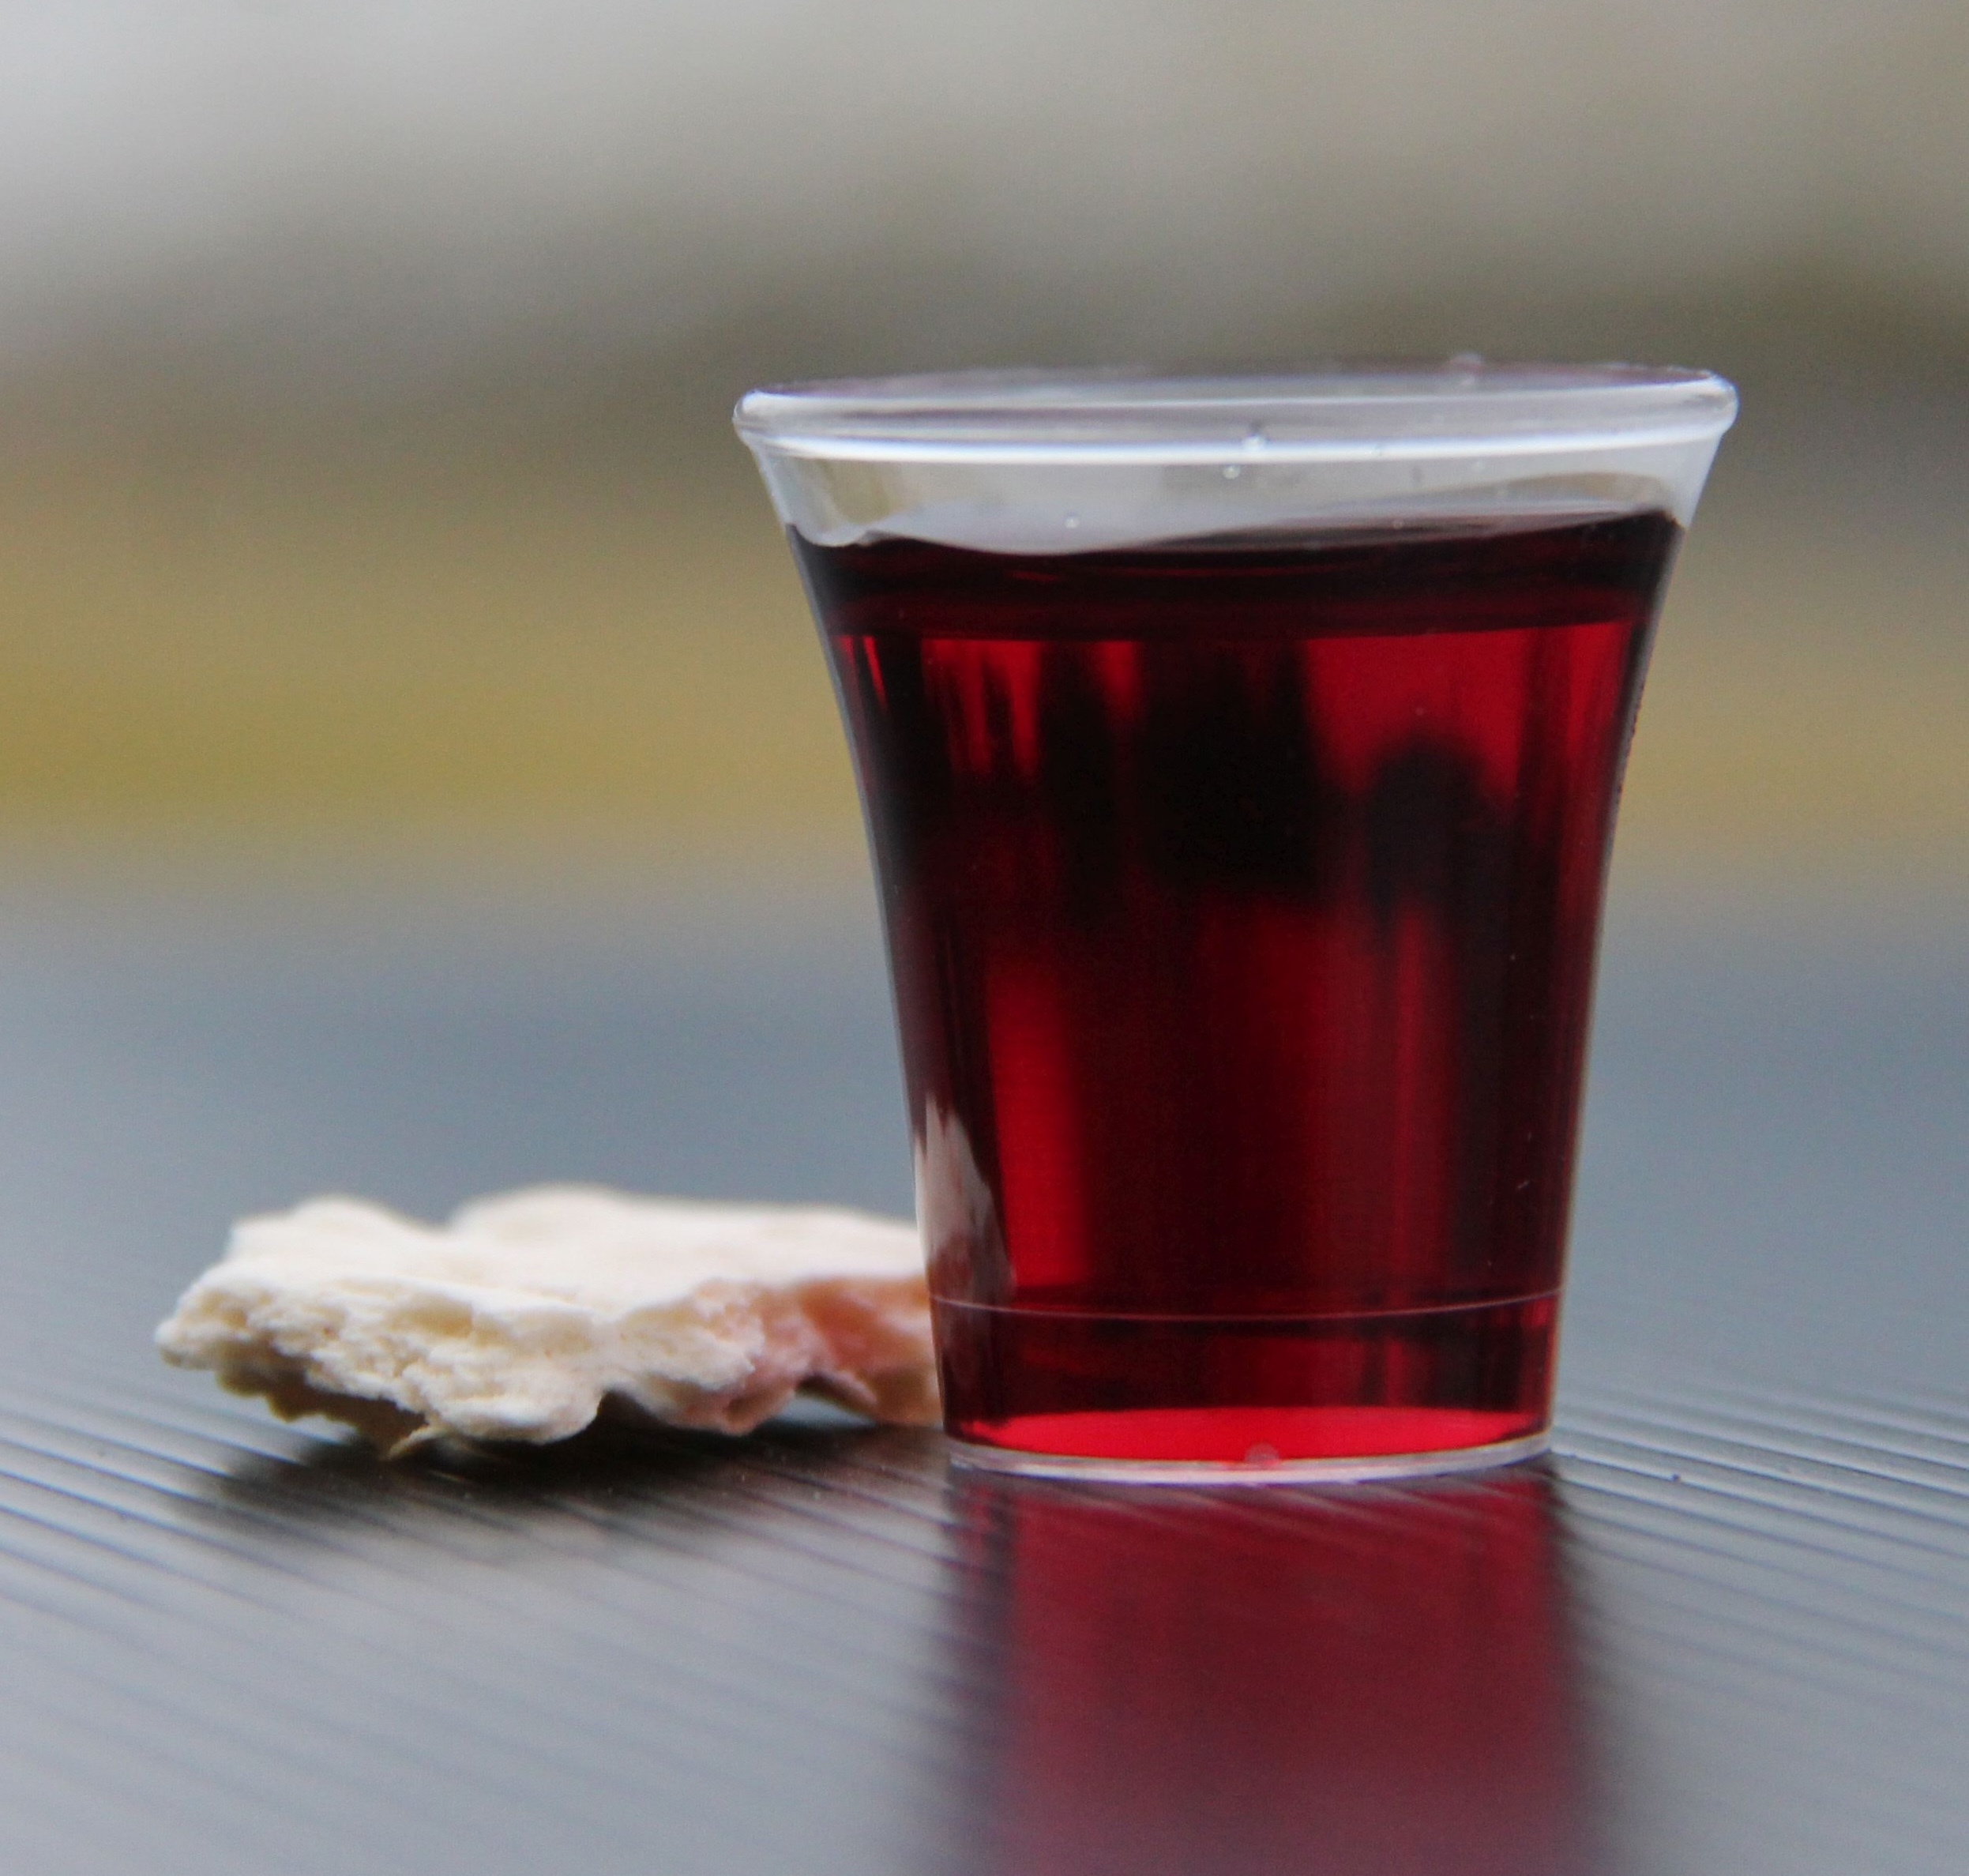
Holy Communion

Slide 40

Bible reading

Slide 41
Genesis 3: 1-19
Now the serpent was more crafty than any of the wild animals the Lord God had made. He said to the woman, “Did God really say, ‘You must not eat from any tree in the garden’?”
² The woman said to the serpent, “We may eat fruit from the trees in the garden,

Slide 42
Genesis 3: 1-19
³ but God did say, ‘You must not eat fruit from the tree that is in the middle of the garden, and you must not touch it, or you will die.’”
⁴ “You will not certainly die,” the serpent said to the woman.

Slide 43
Genesis 3: 1-19
⁵ “For God knows that when you eat from it your eyes will be opened, and you will be like God, knowing good and evil.”
⁶ When the woman saw that the fruit of the tree was good for food and pleasing to the eye, and also desirable for gaining wisdom, she took some and ate it. She also gave some to her husband, who was with her, and he ate it.

Slide 44
Genesis 3: 1-19
⁷ Then the eyes of both of them were opened, and they realized they were naked; so they sewed fig leaves together and made coverings for themselves.
⁸ Then the man and his wife heard the sound of the Lord God as he was walking in the garden in the cool of the day, and they hid from the Lord God among the trees of the garden.

Slide 45
Genesis 3: 1-19
⁹ But the Lord God called to the man, “Where are you?”
¹⁰ He answered, “I heard you in the garden, and I was afraid because I was naked; so I hid.”

Slide 46
Genesis 3: 1-19
¹¹ And he said, “Who told you that you were naked? Have you eaten from the tree that I commanded you not to eat from?”
¹² The man said, “The woman you put here with me—she gave me some fruit from the tree, and I ate it.”

Slide 47
Genesis 3: 1-19
¹³ Then the Lord God said to the woman, “What is this you have done?”
The woman said, “The serpent deceived me, and I ate.”
¹⁴ So the Lord God said to the serpent, “Because you have done this,
“Cursed are you above all livestock
and all wild animals!
You will crawl on your belly
and you will eat dust
all the days of your life.

Slide 48
Genesis 3: 1-19
¹⁵ And I will put enmity
between you and the woman,
and between your offspring and hers;
he will crush your head,
and you will strike his heel.”

Slide 49
Genesis 3: 1-19
¹⁶ To the woman he said,
“I will make your pains in childbearing very severe;
with painful labor you will give birth to children.
Your desire will be for your husband,
and he will rule over you.”

Slide 50
Genesis 3: 1-19
¹⁷ To Adam he said, “Because you listened to your wife and ate fruit from the tree about which I commanded you, ‘You must not eat from it,’
“Cursed is the ground because of you;
through painful toil you will eat food from it
all the days of your life.

Slide 51
Genesis 3: 1-19
¹⁸ It will produce thorns and thistles for you,
and you will eat the plants of the field.
¹⁹ By the sweat of your brow
you will eat your food
until you return to the ground,
since from it you were taken;
for dust you are
and to dust you will return.”

Slide 52
Announcements

Slide 53





Account name: Blacktown Chinese Christian Church
Account number: 4216 50263
Offering
BSB: 112 - 879
Please put in "offering" as the reference
The offering box is available at the back of the hall

Slide 54
Prayer points

Slide 55
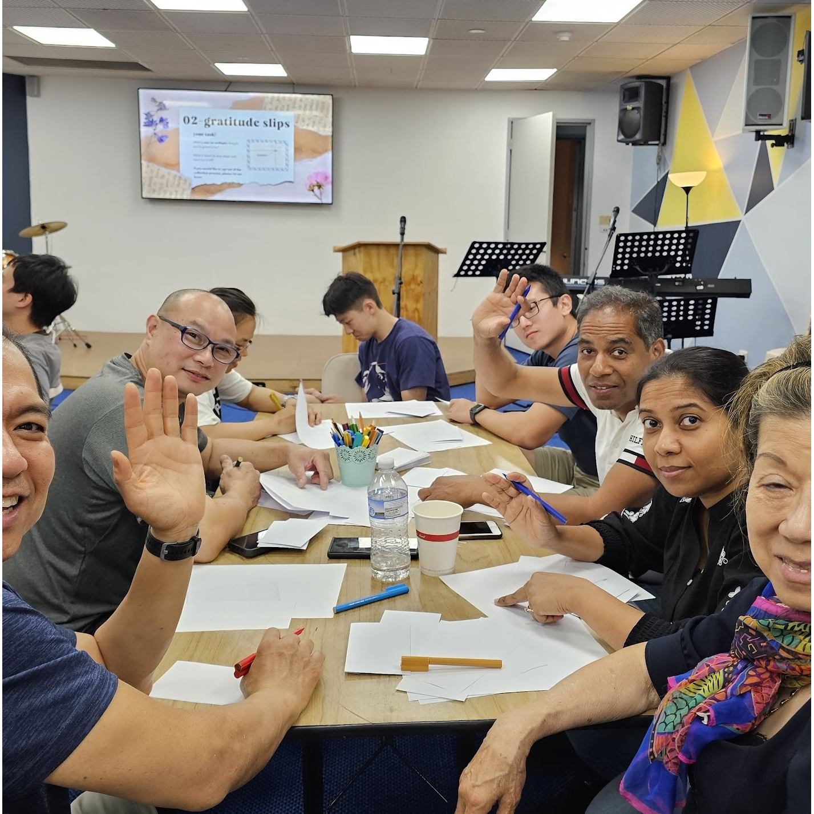
Mingle time!

